Slide 1
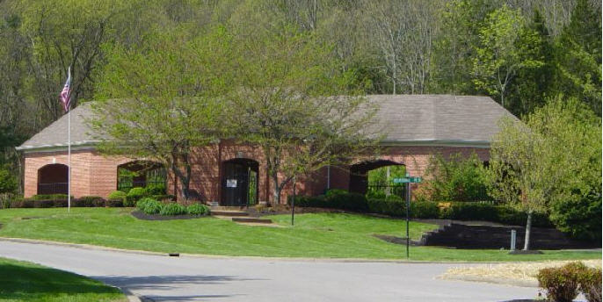
Murray Lane Properties Common Facilities Association, Inc.
Annual Meeting
Thursday, February 18, 2018
Scales Elementary (Cafeteria)

Slide 2
Agenda
Introductions
Approval of minutes (2017)
Committee Reports
Treasurer’s Report
New Business
Adjournment

Slide 3
Organizational Structure
Murray Lane Properties
Common Facilities
Association, Inc.
2 Associations/107 homes
Board Of Directors
Highland View
81 homes / 76%
Mario Crucini, President
Doug Owen, President Elect
Board Of Directors
Waterford
26 homes / 24%
Kim Lowder
President
Board of Directors
Committee Support
Pool Committee
Jon Cornelius (Chair)
Langley & Taylor
Pool Maintenance
Westwood Property Management
Hoil Crowe

Slide 4
Quorum and Minutes
Jay Hollis, Secretary
Affirmation of quorum by Hoil Crowe
Call for corrections to minutes from Feb 2017
Motion and second to approve existing or amended minutes

Slide 5
2017 Pool Committee
The goal of the committee is to ensure the pool and pool pavilion meet the expectations of residents of Highland View and Waterford as a key amenity for the enjoyment of all residents. The pool committee oversees a budget of approximately
$ 20K (not including capital expenses).
Jon Cornelius (Chair)
Deanna Cornelius
Jenny Hyams
Patty Shultz
Mike Umphres

Slide 6
Pool Committee Report
2017 Year in review:
Pool deck full repaint, refurbish pavilion floor add drains ($9,050)
New stone reinforcing wall at pool parking lot ($ 6.5K)
Looking forward to 2018:
Brickwork repairs and refurbishing at pool and pavillion
Refurbishing of fence-work at pool

Slide 7
Treasurer’s Report
Review of 2017 results
Budget for 2018
Reserve Modeling

Slide 8
Treasurer’s Report

Slide 9
2018 Budget

Slide 10
Reserve Modeling
Reserves are balances held in order to pay for large capital expenses both planned and unforeseen
Planned means on a expected cycle based on expected life of physical asset or equipment (resurfacing of pool deck, replacement of recirculating pumps, etc.)
Based on engineering study: 1996 (GEC) and formal financial analysis: 2011 (McLaughlin and Crucini)

Slide 11
Reserve growth: Too Fast, Too Slow, Just Right?
Net income adds to reserves while capital expenditure depletes them; striking a balance requires adjustments from time-to-time
In 2012, projections indicated reserve balances heading toward zero. Grounds budget at pool was reallocated 100% to Highland View to compensate.
Reserves are now growing too quickly.
Dues reduction in 2017 from $93.75 to $85.00 per quarter
Recommending reversal of 2012 pool grounds allocation back to 85/15% split between HV and ML.

Slide 12
Historical and Projected Murray Lane Reserve Balances

Slide 13
New Business
Trail work-day
Raised wooden walk-way at trail entry by pool
Removal of four trees from trail
Accounts receivable are running high, we have auto-draft forms and instructions to share with neighbors to keep payments on track
Other business

Slide 14
Adjourn

